Slide 1
Eigenvalues and Eigenvectors
4.2 The Characteristic Equation
Bumhee Cho

Slide 2
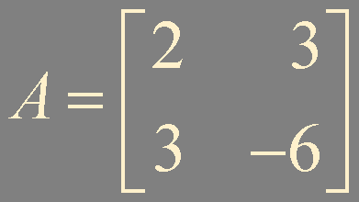

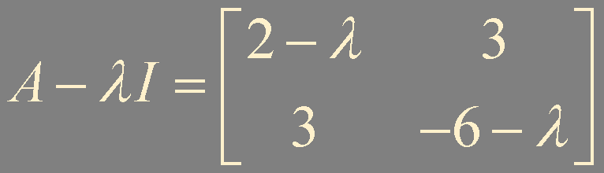
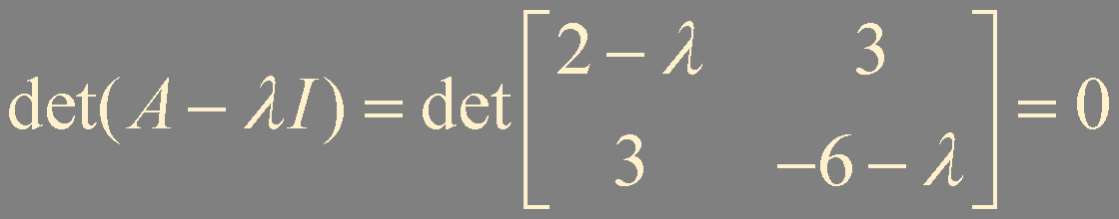




CH3 Theorem 4
A square matrix A is invertible if and only if det A ≠ 0

Slide 3
The Characteristic Equation
A scalar λ is an eigenvalue of an n × n matrix A if and only if λ satisfies the characteristic equation
det (A - λI) = 0

Slide 4
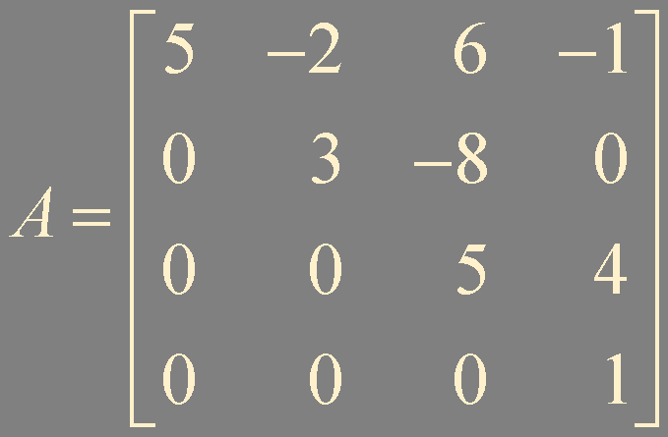
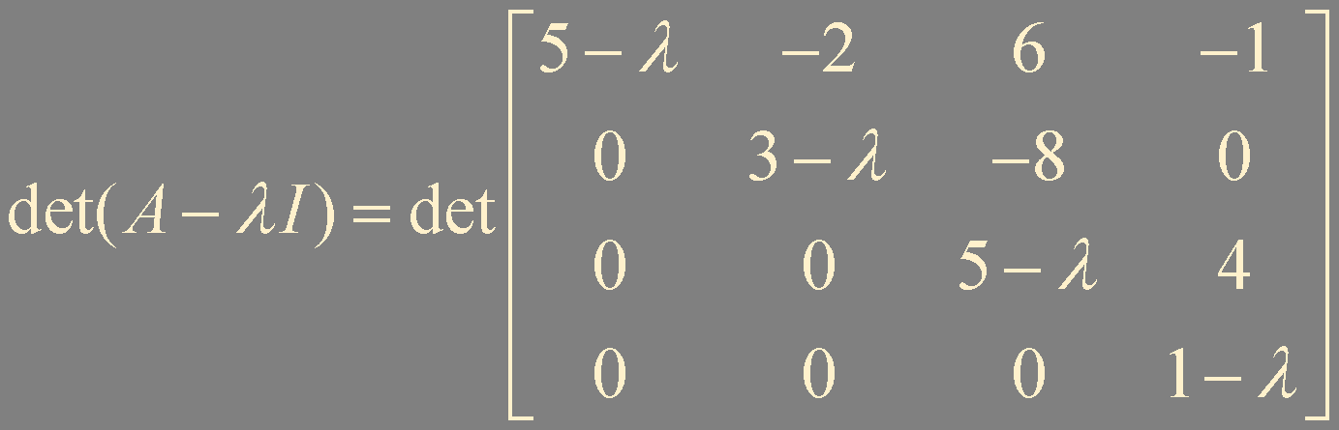
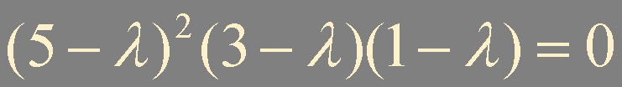
Example 1.
n-th degree characteristic polynomial
eigenvalue 5 have multiplicity 2

Slide 5
Similarity
If A and B are n × n matrices, then A is similar to B
if there is an invertible matrix P such that P⁻¹AP = B, or equivalently, A = PBP⁻¹
A and B are similar
similarity transformation

Slide 6
Theorem 3.
If n × n matrices A and B are similar,
then they have the same characteristic polynomial and hence the same eigenvalues (with the same multiplicities)
B = P⁻¹AP
B - λI = P⁻¹AP - λP⁻¹P
= P⁻¹(AP - λP)
= P⁻¹(A - λI)P
det (B - λI) = det (P⁻¹(A - λI)P)
= det (P⁻¹)·det (A - λI)·det(P)
= det (P⁻¹P)·det (A - λI)
= det (A - λI)

Slide 7
Numerical Notes
There is no analytic formula or finite algorithm to solve the characteristic equation for n ≥ 5
The characteristic polynomial is given in the following form
(λ - λ₁)(λ - λ₂)⋯(λ - λ_{n})
after computing the eigenvalues first
QR algorithm is commonly used for estimating the eigenvalues

Slide 8
QR Algorithm (not in detail)
If A = QR with Q invertible, then A is similar to A₁ = RQ
R = Q⁻¹A
A₁ = Q⁻¹AQ
Q⁻¹ = Q^{T}
R = upper triangular
A = Q₁R₁
A₁ = R₁Q₁
A₁ = Q₂R₂
A₂ = R₂Q₂
⋯
A_{k} converges to a triangular matrix (under certain conditions)
*Wilkinson shift

Slide 9
Summary
Characteristic equation
Characteristic polynomial
Similarity

